Slide 1
Design and Analysis of Algorithms CSE332s

Slide 2

Team Names & ID
Omar Mohamed Diaaeldin Ibrahim 1802932

Slide 3
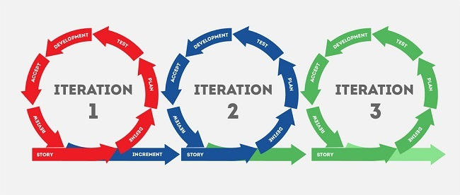
Iterative Improvement

Slide 4
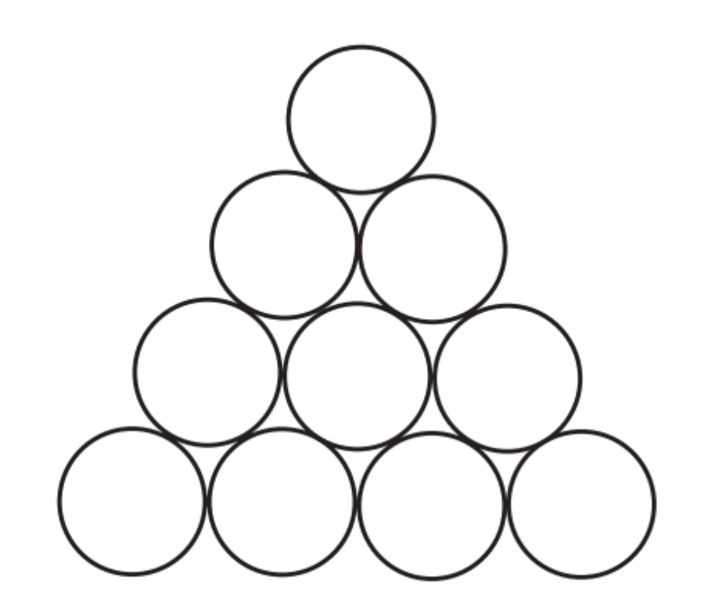
Task 1
Problem Description:
Inverting a Coin Triangle Consider an equilateral triangle formed by closely packed pennies or other identical coins like the one shown in the figure below. (The centers of the coins are assumed to be at the points of the equilateral triangular lattice.)
Use iterative improvement method to design an algorithm to flip the triangle upside down in the minimum number of moves if on each move you can slide one coin at a time to its new position.

Slide 5
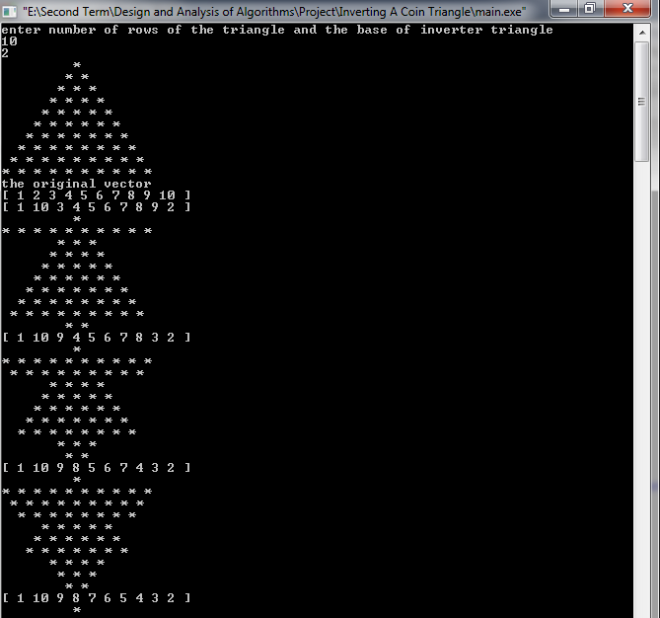
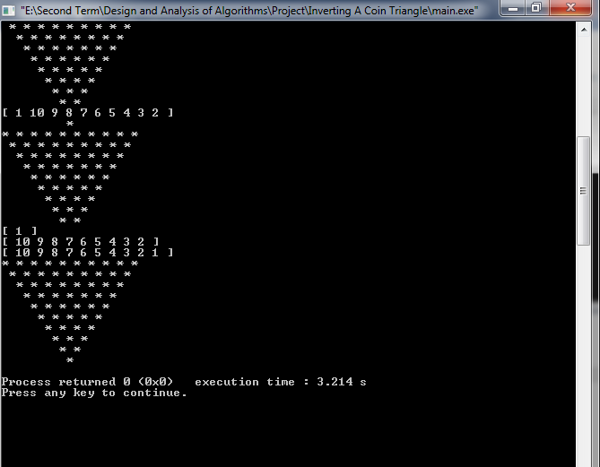
Sample Output of the solution

Slide 6

Complexity Analysis for the algorithm
Let M(k) be the number of moves made by the iterative algorithm
$$M\left(k\right)=\sum_{j=0}^{\left\lfloor \frac{n−k}{2}\right\rfloor }{\left(n−k−2j\right)}+ \sum_{j=1}^{k−1}{j}= \sum_{j=0}^{\left\lfloor \frac{n−k}{2}\right\rfloor }{\left(n−k\right)}−\sum_{j=0}^{\left\lfloor \frac{n−k}{2}\right\rfloor }{2j}+ \sum_{j=1}^{k−1}{j}$$
$$=\left(n−k\right)\left(\left\lfloor \frac{n−k}{2}\right\rfloor +1\right)−\left\lfloor \frac{n−k}{2}\right\rfloor \left(\left\lfloor \frac{n−k}{2}\right\rfloor +1\right)+\frac{\left(k−1\right)k}{2}∗$$
$$\left(\left\lfloor \frac{n−k}{2}\right\rfloor +1\right)\left\lfloor \frac{n−k}{2}\right\rfloor +\frac{\left(k−1\right)k}{2}$$
If n-k is even
$$M\left(k\right)=\left(\frac{n−k}{2}+1 \right)\frac{n−k}{2}+ \frac{\left(k−1\right)k}{2}= \frac{3k^{2}−\left(2n+4\right)k+n^{2}+2n}{4}$$
If n-k is odd
$$M\left(k\right)=\left(\frac{n−k−1}{2}+1\right)\frac{n−k+1}{2}+ \frac{\left(k−1\right)k}{2} = \frac{3k^{2}−\left(2n+4\right)k+{\left(n+1\right)}^{2}}{4}$$
Minimum value of M(k) is @ k= (n+2)/3
If k is an integer $→\left(n−k\right)=\left(3i+1\right)−\frac{3i+1+2}{3}=2i , which is even \& a unique solution$
If k is not an integer$→k^{−}=\left\lfloor \frac{n+2}{3}\right\rfloor , k^{+}= \left\lceil \frac{n+2}{3}\right\rceil$
$$T\left(n\right)=θ\left(n^{2}\right)$$

Slide 7
Conclusion:
Using the cut-off triangle makes it easy to modify the iterative improvement algorithm to satisfy the additional requirement that “on each move a coin must be slid to a new position so that to touch two other coins that rigidly determine its new position”.
Rather than moving coins a horizontal row by a horizontal row, we can slide all the coins in a cut-off triangle to their designated locations in the inverted triangle by always taking an outside
coin from the triangle given and sliding it to its new location where it touches at least two other coins.

Slide 8

Dynamic Programming

Slide 9
Task 2
Problem Description:
Consider the one-dimensional version of peg solitaire played on an array of n cells, where n is even and greater than 2. Initially, all but one cell are occupied by some counters (pegs), one peg per cell. On each move, a peg jumps over its immediate neighbor to the left or to the right to land on an empty cell; after the jump, the jumped-over neighbor is removed from the board.

Slide 10
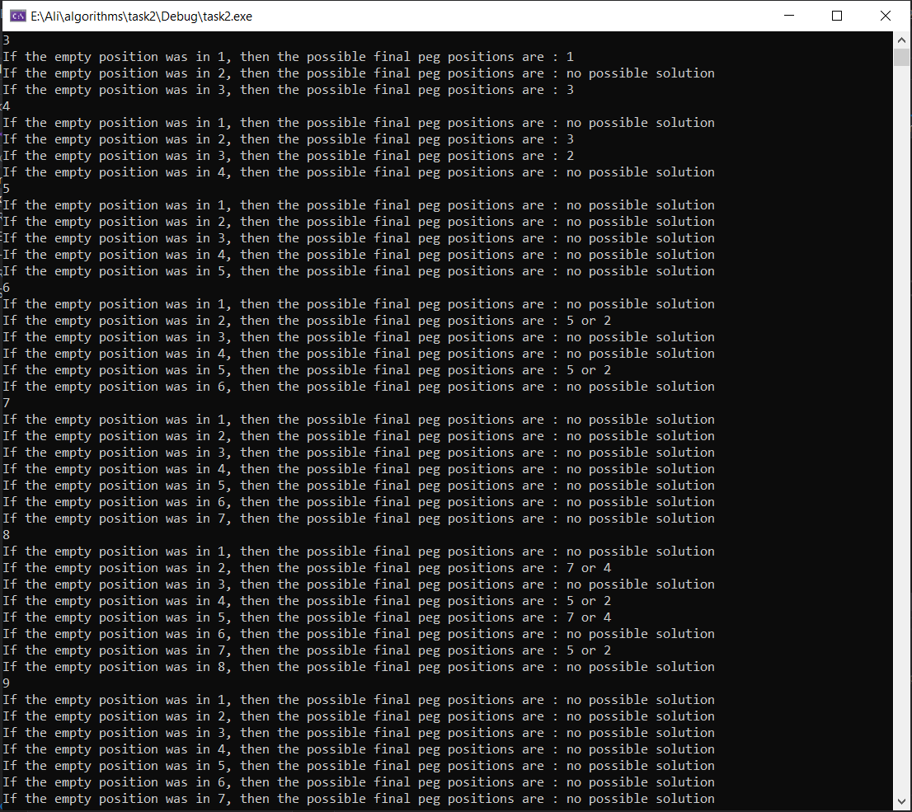
Sample Output

Slide 11
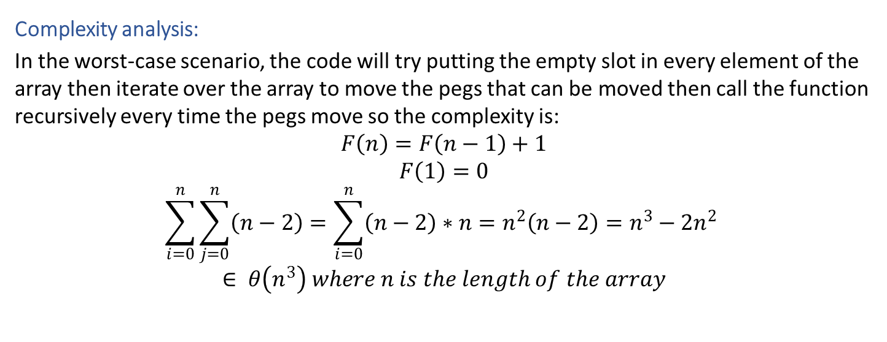
Solution & complexity
Complexity analysis:
In the worst-case scenario, the code will try putting the empty slot in every element of the array then iterate over the array to move the pegs that can be moved then call the function recursively every time the pegs move so the complexity is:
$$F\left(n\right)=F\left(n−1\right)+1$$
$$F\left(1\right)=0$$
$$\sum_{i=0}^{n}{\sum_{j=0}^{n}{\left(n−2\right)}}=\sum_{i=0}^{n}{\left(n−2\right)∗n}=n^{2}\left(n−2\right)=n^{3}−2n^{2}$$
$$∈ θ\left(n^{3}\right) where n is the length of the array$$

Slide 12
Conclusion
Dynamic Programming optimize solution and makes a minimal time complexity than normal recurrence method.
The puzzle is a one-dimensional version of the old but still popular game played by the same rules on two-dimensional boards.

Slide 13
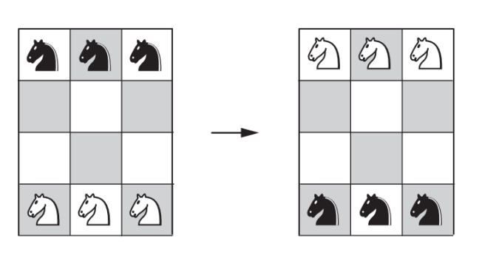
Task 3
Problem description:
We have six knights on 3x4 chessboard, three white knights on the bottom row and three black knights on the top row.
We want to exchange the white and black knights as shown in Figure 2 using a divide and conquer algorithm in the minimum number of moves.

Slide 14
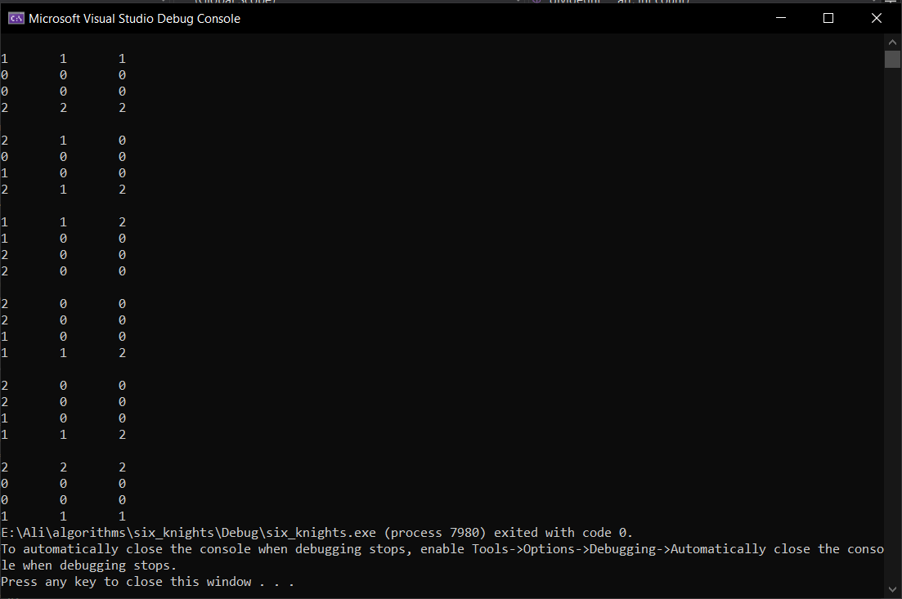
Sample Output

Slide 15
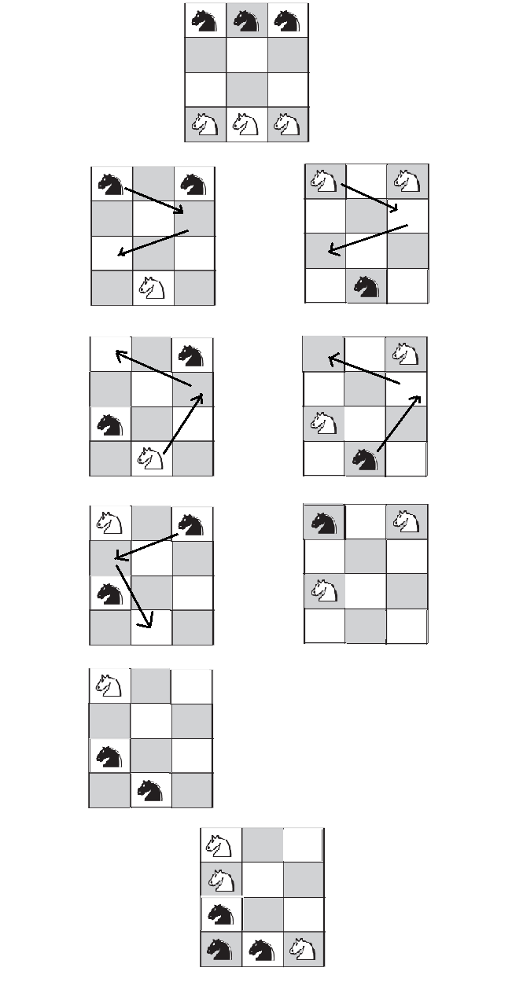
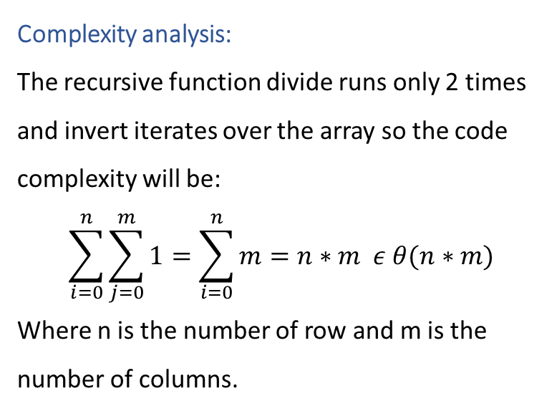
Solution & complexity
Complexity analysis:
The recursive function divide runs only 2 times and invert iterates over the array so the code complexity will be:
$$\sum_{i=0}^{n}{\sum_{j=0}^{m}{1}}=\sum_{i=0}^{n}{m}=n∗m ε θ(n∗m)$$
Where n is the number of row and m is the number of columns.

Slide 16
Conclusion:
Dividing a problem into smaller subproblems is a better approach than trying to solve it as a whole. By dividing this problem we could focus on a solution to an easier one then we could merge these solution to solve the original problem.

Slide 17
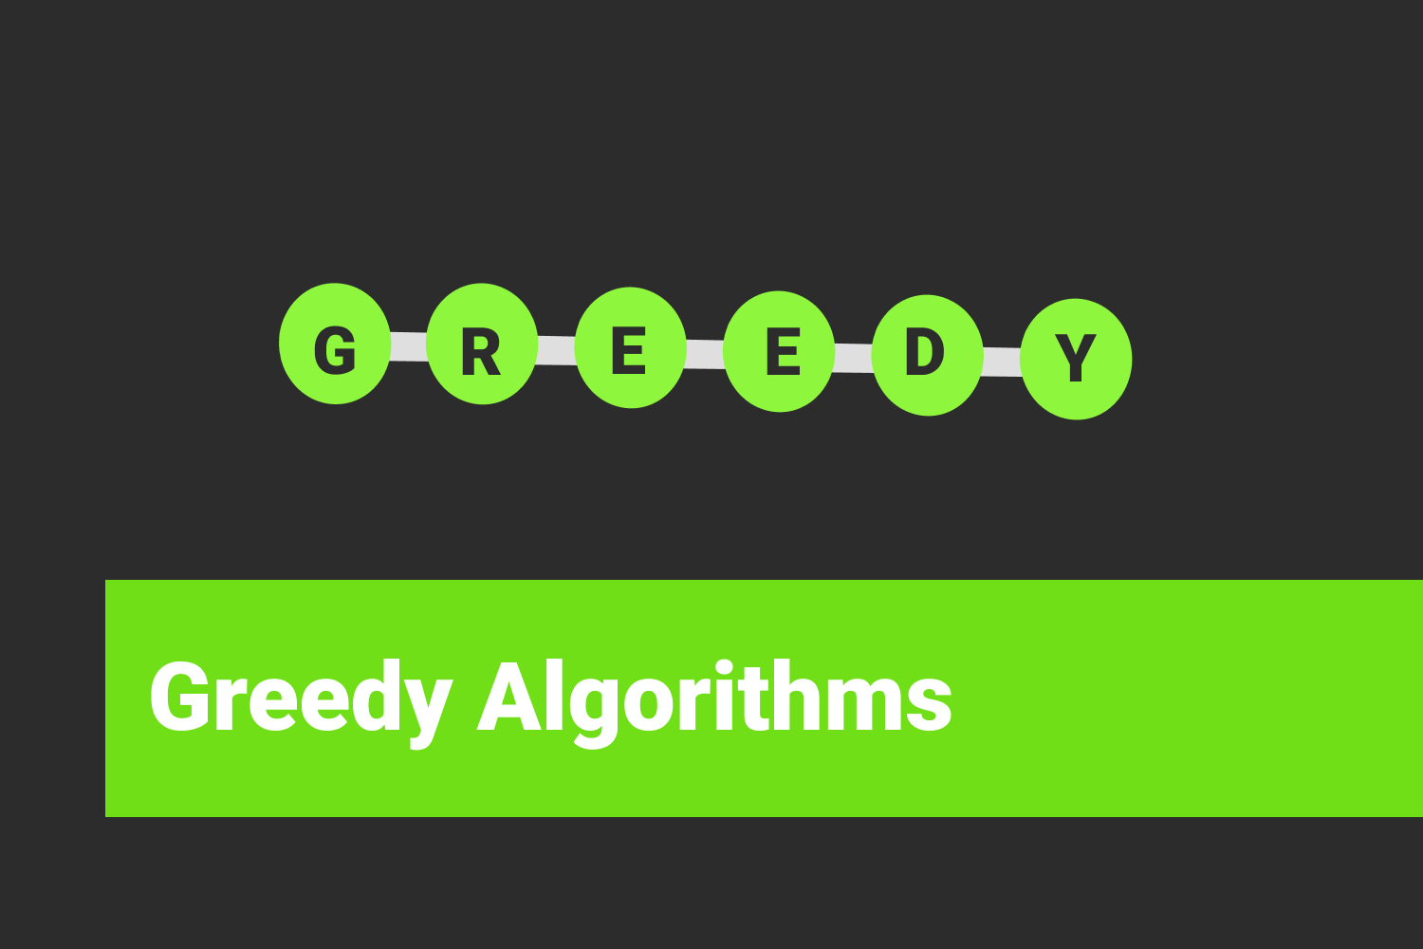
Greedy Algorithms

Slide 18
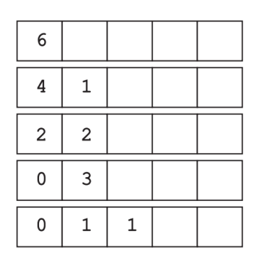
Task 4
Problem Description:
A “machine” consists of a row of boxes. To start, one places n pennies in the leftmost box. The machine then redistributes the pennies as follows. On each iteration, it replaces a pair of pennies in one box with a single penny in the next box to the right. The iterations stop when there is no box with more than one coin. For example, see the figure that shows the work of the machine in distributing six pennies by always selecting a pair of pennies in the leftmost box with at least two coins.

Slide 19
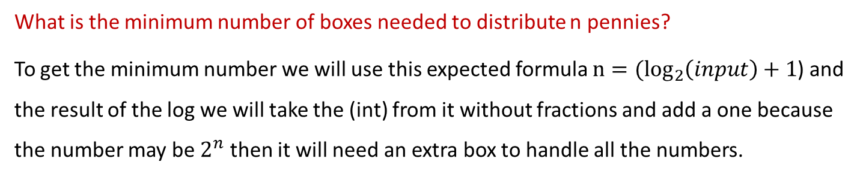
Answers of the questions in the task
Does the final distribution of pennies depend on the order in which the machine processes the coin pairs?
No, it doesn’t depend on the order because steps may be different from an implementation to another, but the final distribution must be the same.
What is the minimum number of boxes needed to distribute n pennies?
To get the minimum number we will use this expected formula ${n=(log}_{2}\left(input\right)+1$) and the result of the log we will take the (int) from it without fractions and add a one because the number may be $2^{n}$ then it will need an extra box to handle all the numbers.

Slide 20
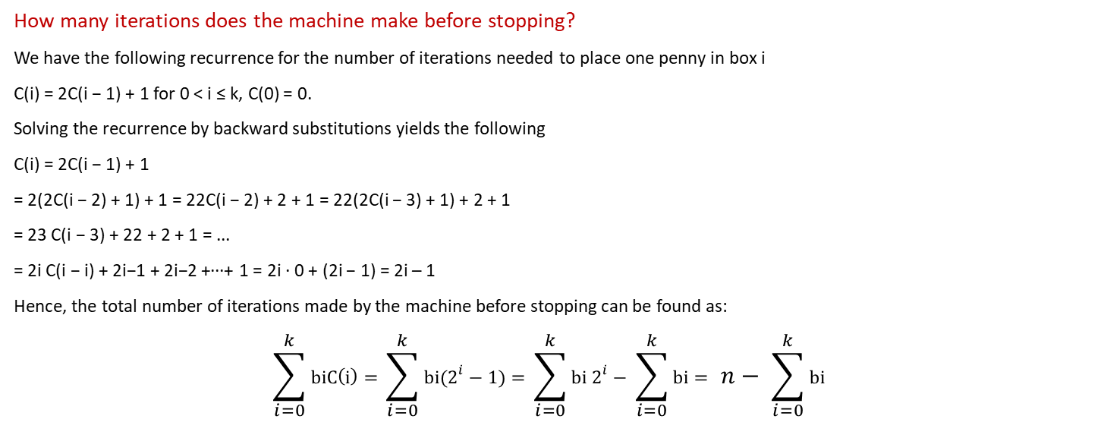
Answers of the questions in the task
How many iterations does the machine make before stopping?
We have the following recurrence for the number of iterations needed to place one penny in box i
C(i) = 2C(i − 1) + 1 for 0 < i ≤ k, C(0) = 0.
Solving the recurrence by backward substitutions yields the following
C(i) = 2C(i − 1) + 1
= 2(2C(i − 2) + 1) + 1 = 22C(i − 2) + 2 + 1 = 22(2C(i − 3) + 1) + 2 + 1
= 23 C(i − 3) + 22 + 2 + 1 = ...
= 2i C(i − i) + 2i−1 + 2i−2 +···+ 1 = 2i · 0 + (2i − 1) = 2i – 1
Hence, the total number of iterations made by the machine before stopping can be found as:
$$\sum_{i=0}^{k}{biC\left(i\right)= }\sum_{i=0}^{k}{bi(2^{i}−1)= }\sum_{i=0}^{k}{bi 2^{i}− }\sum_{i=0}^{k}{bi= }n− \sum_{i=0}^{k}{bi }$$

Slide 21
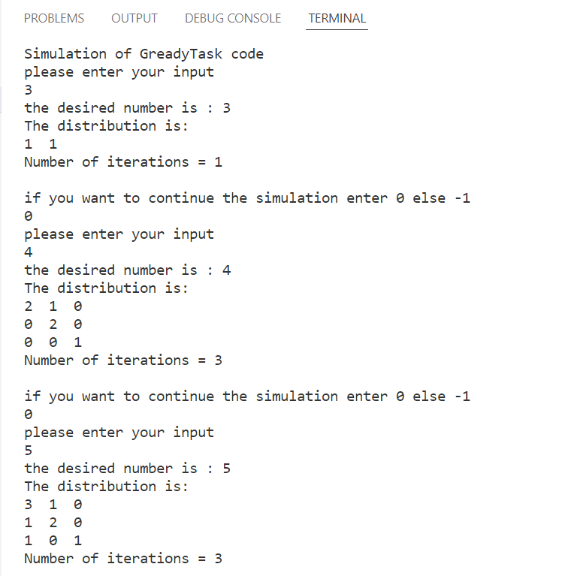
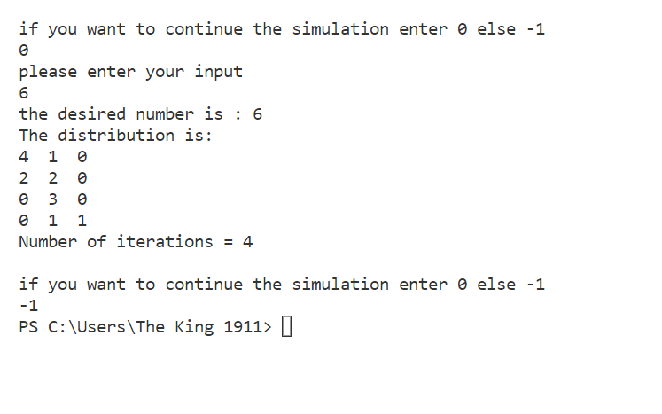
Sample Output
Sample output
➔

Slide 22
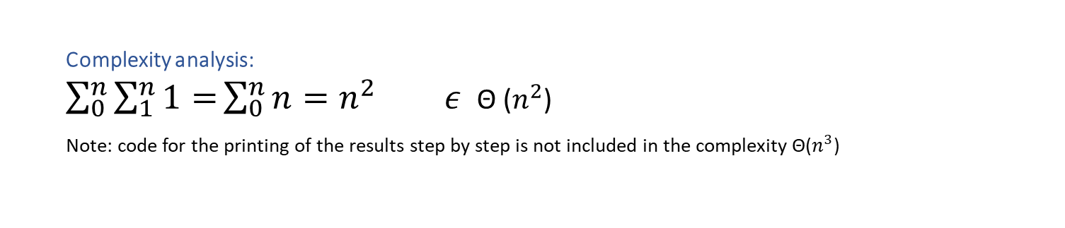
Complexity analysis & Conclusion
Complexity analysis:
$\sum_{0}^{n}{\sum_{1}^{n}{1=}}\sum_{0}^{n}{n=n^{2}} ε$Θ ($n^{2}$)
Note: code for the printing of the results step by step is not included in the complexity Θ($n^{3}$)
Conclusion:
Greedy algorithm is the most suitable algorithm to solve this problem as wanted to complete all the operations needed in the most right box then move to the next.

Slide 23

Divide and Conquer

Slide 24
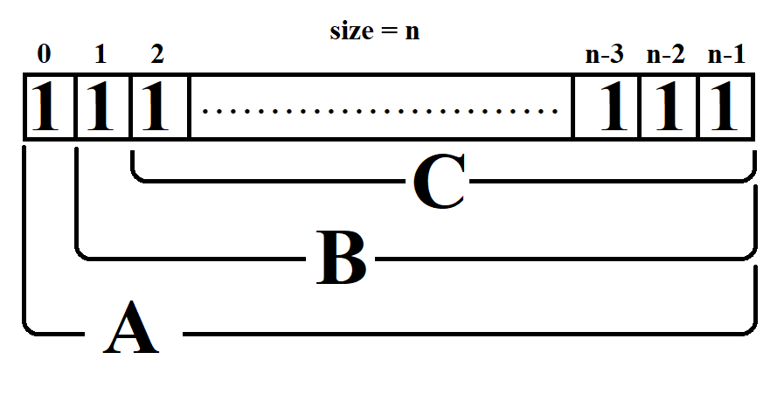
Task 5
Description of the problem:
We want Have a set of switches at a certain time they are all on and we would like to turn off a certain switch, but we can't do that unless certain conditions are satisfied. 1.If the switch to its immediate right is on and all the other switches to its right, if any, are off.
2.We Toggle only one switch at a time.

Slide 25
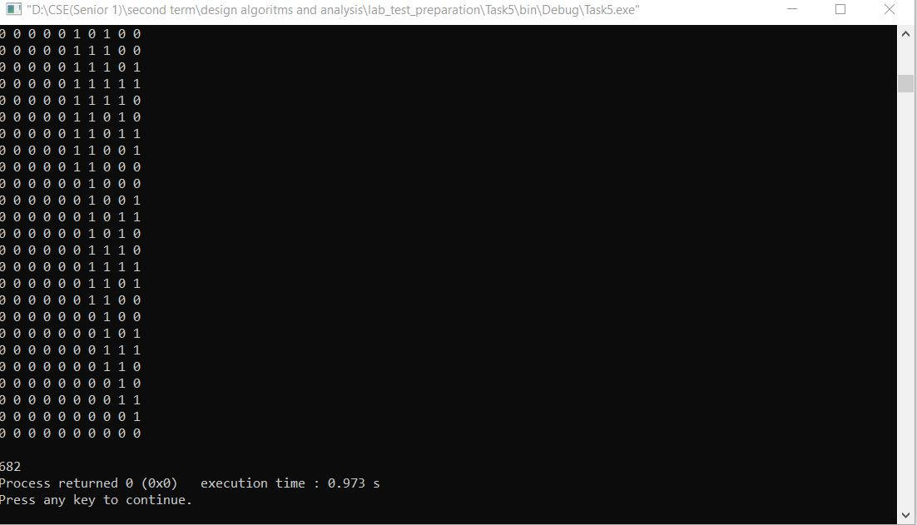
Sample Output
Sample Output when number of switches(n) = 10

Slide 26

Complexity
Complexity:
$$d\left(n\right)=d\left(n−2\right)+d\left(n−1\right)+u\left(n−2\right) →1$$
$$d\left(1\right)=1$$
$$d\left(2\right)=1$$
$$u\left(n\right)= u\left(n−2\right)+u\left(n−1\right)+d\left(n−2\right) →2$$
$$u\left(1\right)=1$$
$$u\left(2\right)=1$$
$$d\left(n\right)−u\left(n\right)=d\left(n−1\right)−u\left(n−1\right) →3$$
From 1,2 and 3 we find that $d\left(n\right)=u(n)$
$$∴d\left(n\right)=2d\left(n−2\right)+d\left(n−1\right)$$
And this is similar to the problem of "Tower of Hanoi" as in order to turn all switches off, we need to turn off sub-vector from the original vector and then turn it on after doing something in between. So $d\left(n\right)∈O\left(2^{n}\right)$

Slide 27
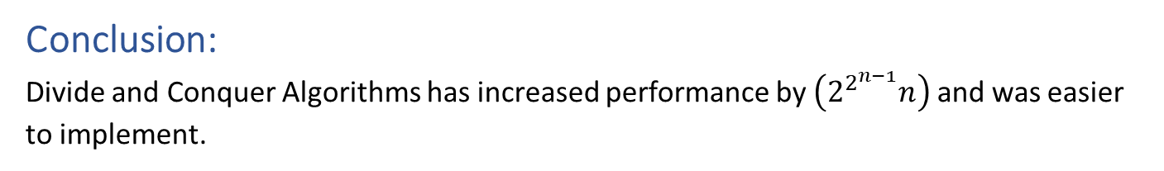
Comparison
Conclusion:
Divide and Conquer Algorithms has increased performance by $\left(2^{2^{n−1}}n\right)$ and was easier to implement.

Slide 28
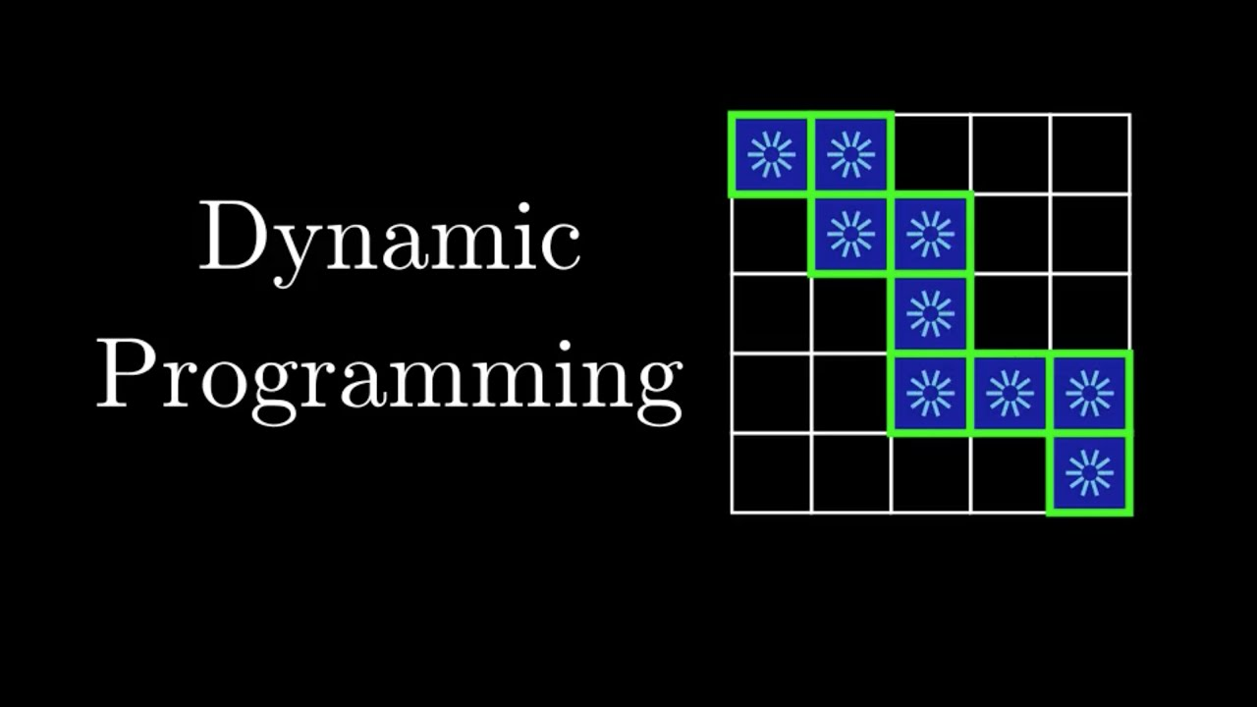
Dynamic Programming

Slide 29
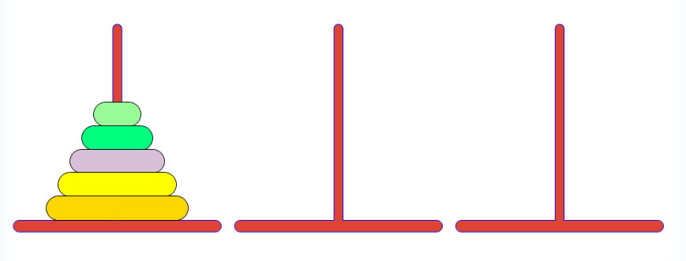
Task 6
Description of the problem:
The extension of the Tower of Hanoi puzzle to more than three pegs was suggested by the French mathematician Édouard Lucas in 1889, who invented the original three-peg version a few years earlier. Under the name The Reve’s Puzzle, it appeared in Henry E. Dudeney’s first puzzle book The Canterbury Puzzles [Dud02], where he gave the solutions for n = 8, 10, and 21. Later, more detailed analyses of the above algorithm have produced alternative formulas for the optimal value of the partition parameter k.

Slide 30
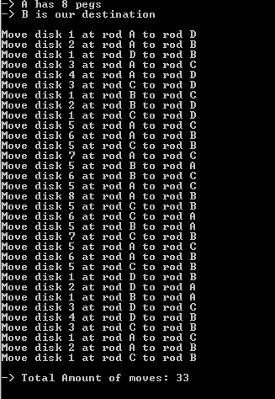
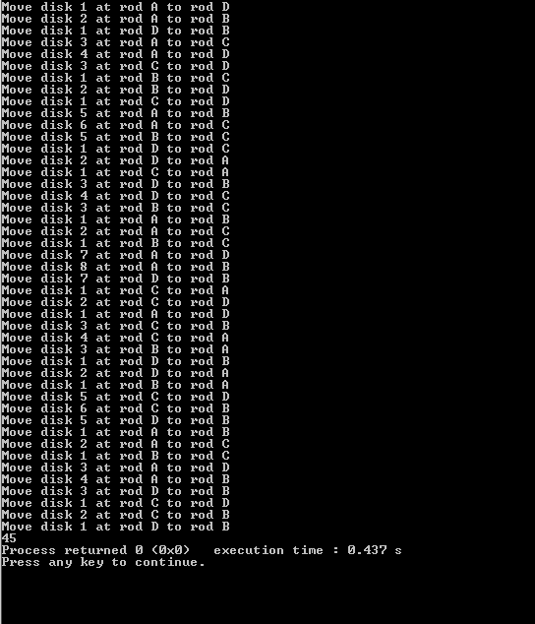
Sample Output

Slide 31
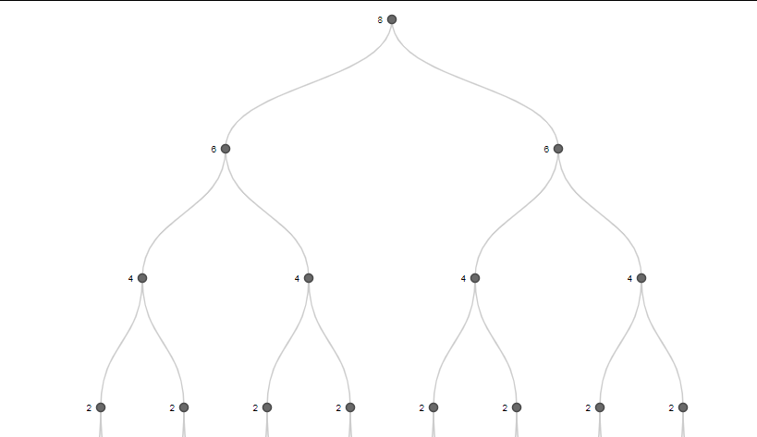
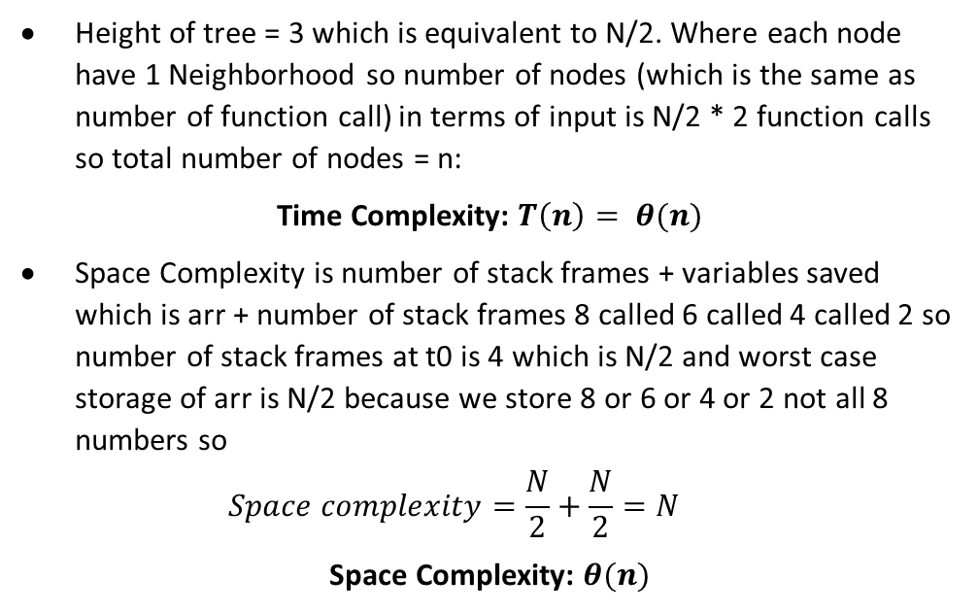
Complexity
Height of tree = 3 which is equivalent to N/2. Where each node have 1 Neighborhood so number of nodes (which is the same as number of function call) in terms of input is N/2 * 2 function calls so total number of nodes = n:
Time Complexity: $T\left(n\right)= θ(n)$
Space Complexity is number of stack frames + variables saved which is arr + number of stack frames 8 called 6 called 4 called 2 so number of stack frames at t0 is 4 which is N/2 and worst case storage of arr is N/2 because we store 8 or 6 or 4 or 2 not all 8 numbers so
$$Space complexity=\frac{N}{2}+\frac{N}{2}=N$$
Space Complexity: $θ(n)$

Slide 32
Conclusion
Dynamic Programming optimize solution and makes a minimal time complexity than normal recurrence method.
Although Dynamic Programming optimize solution there is still more optimized solution as at
k = N/2, 33 steps are needed to move 8 discs and this is the most optimized solution

